Slide 1
Joints of the Human Body

Slide 2
What is a joint?
Location at which two or more bones meet
Allow movement and provide mechanical support

Slide 3
Classification
Structural | Functional
Fibrous :joined by dense connective tissue | Little or no movement
Cartilaginous: joined by cartilage | Slight movement
Synovial: joined by joint capsule | Freely movable

Slide 4
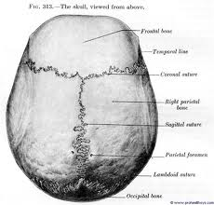
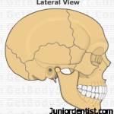
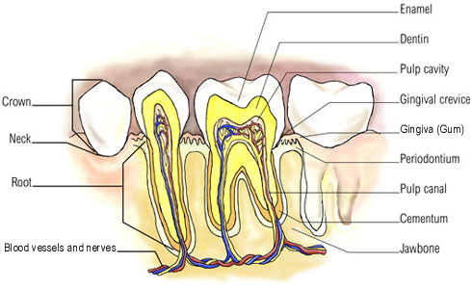
Fibrous Joints
Held together by thin layer of strong connective tissue
No movement between the bones
Ex: sutures of the skull, teeth in sockets

Slide 5
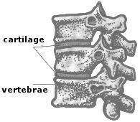
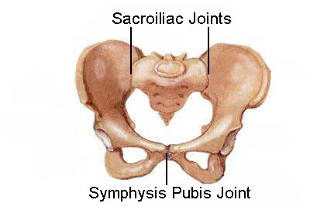
Cartilaginous Joints
Attached by discs made of cartilage and ligaments
Allow a limited degree of movement
Ex: vertebrae of spine, pubis joint

Slide 6
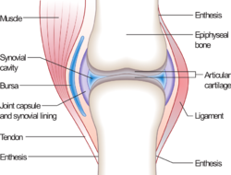
Synovial Joints
Freely movable joints
All contain joint capsule (holds together), synovial cavity, and joint cartilage
Sub-divided into groups depending on type of movement
Ball-and-Socket Joints
Hinge Joints
Gliding Joints
Pivot Joints

Slide 7
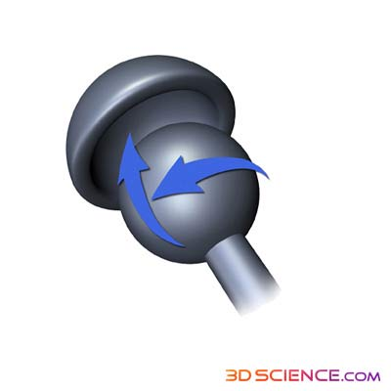
Ball-and-Socket Joint
Ball-shaped bone fits into the cup-like space of another bone
Allows movement in almost all directions
Ex: shoulder (humerus/glenoid fossa),
hip (femur, acetabulum)

Slide 8
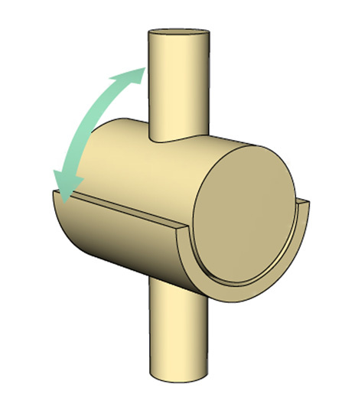
Hinge Joint
Convex part of one bone fits into concave part of another, allowing motion in only one plane
Ex: elbow, knee

Slide 9
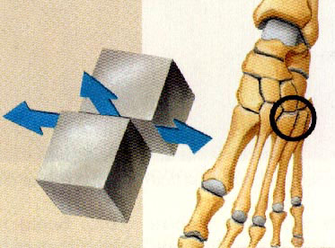
Gliding Joints
Joint surfaces are nearly flat or slightly curved
Allow sliding or back-and forth motions and twisting movements
Ex: wrist and ankle

Slide 10
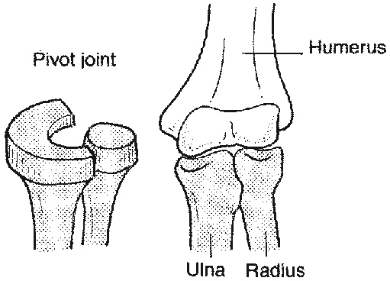
Pivot Joint
The end of one bone having a ‘peg’ that fits into a ‘ring’ formed by the other bone
Movement limited to rotation
Ex: neck rotating side to side, radius and ulna

